Slide 1

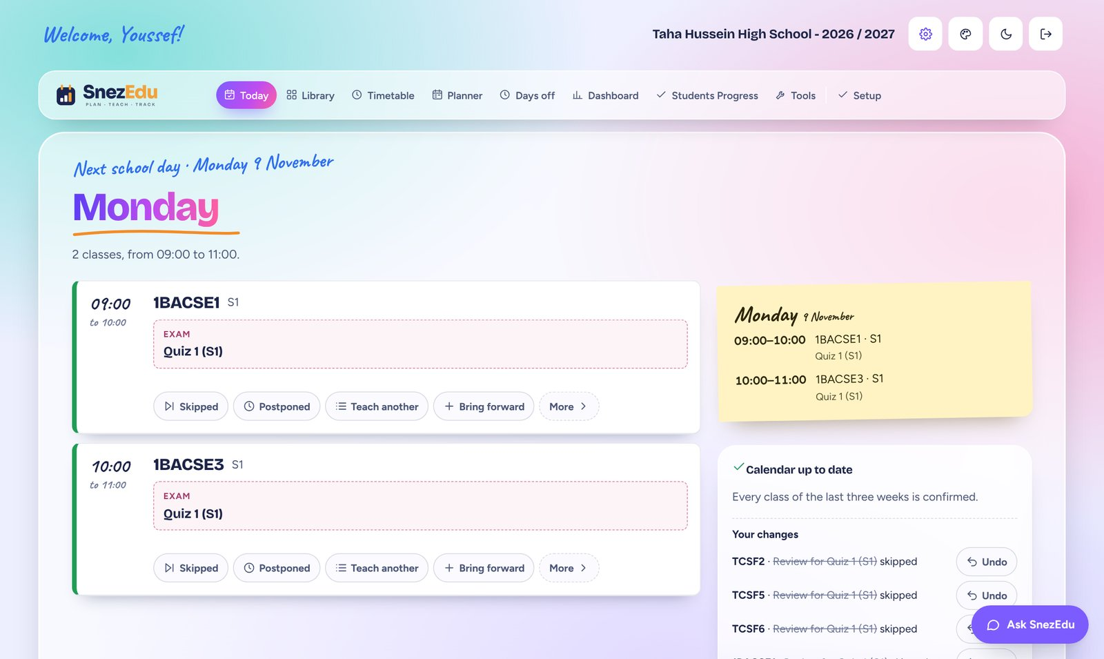
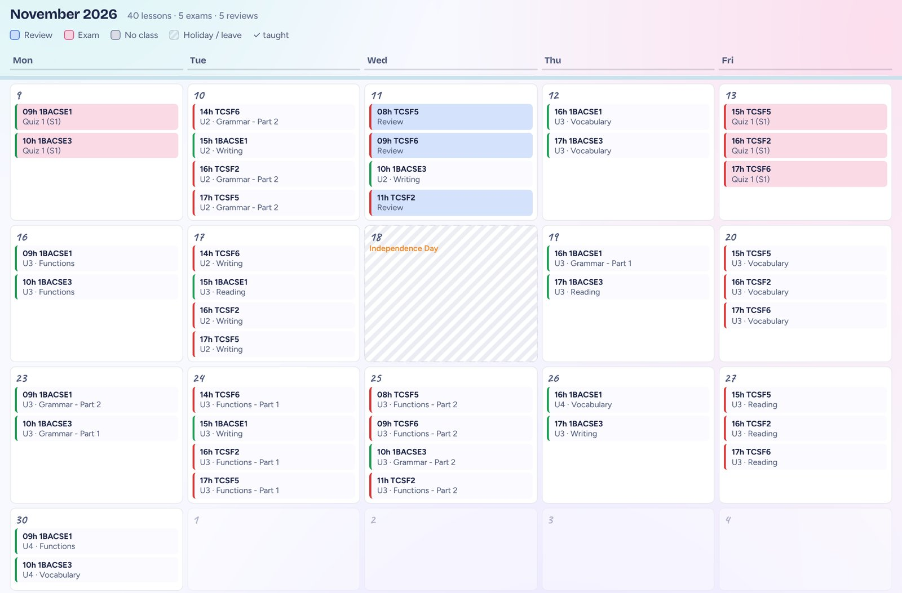
A PRODUCT STORY
How a teacher’s planner grew into a learning platform.
Youssef Nejjar · Teacher of English
Notes:
A four-chapter story: a planner, one place for every lesson, AI that does the paperwork, and finally an online experience for students.

Slide 2
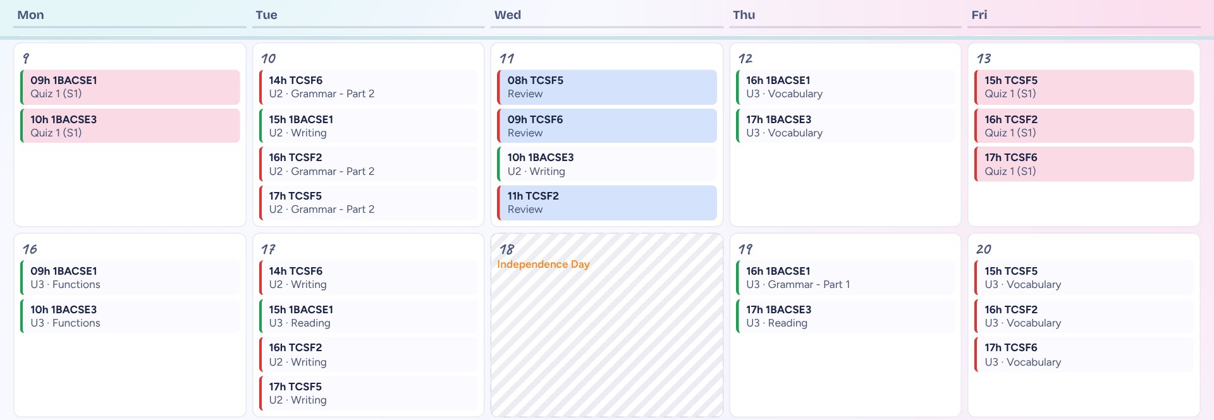
It started with a planner
01
The whole year on one screen. Every class, quiz, review and holiday.
Notes:
Five classes at different points in the book. The planner uses the timetable, holidays, leave and exam plan, and warns me when a class is behind the ministerial dates. Pink is a quiz, blue is a review session, and hatched days are holidays.

Slide 3

Four inputs, one clear answer
HOW THE PLANNER THINKS
Timetable and rooms
The next lesson
for every class, every day
Holidays and leave
Planner
A warning
Quizzes and exam dates
for each of the five classes
when a class will miss a ministerial date
Lessons already taught
Easy changes
move, skip or swap lessons in one tap
Notes:
The planner works out the programme of each class: its lessons unit by unit, then the review sessions and the quiz or global test. A holiday or a leave day has no session, so everything after it moves. When a class is behind, it says how many classes to skip or combine, and a Help me catch up button suggests how.

Slide 4
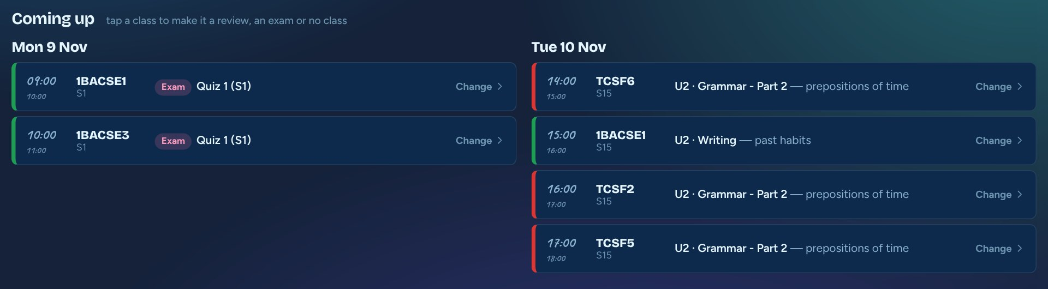
The week ahead, class by class
THE TIMETABLE
Each class follows its lessons in order. A holiday or leave day moves everything to the next class.
Notes:
This screen is shown in night mode on purpose, to show that every screen has a light and a night theme. It lists the coming school days, the room and the lesson each class should teach, and a Change button on each line.

Slide 5
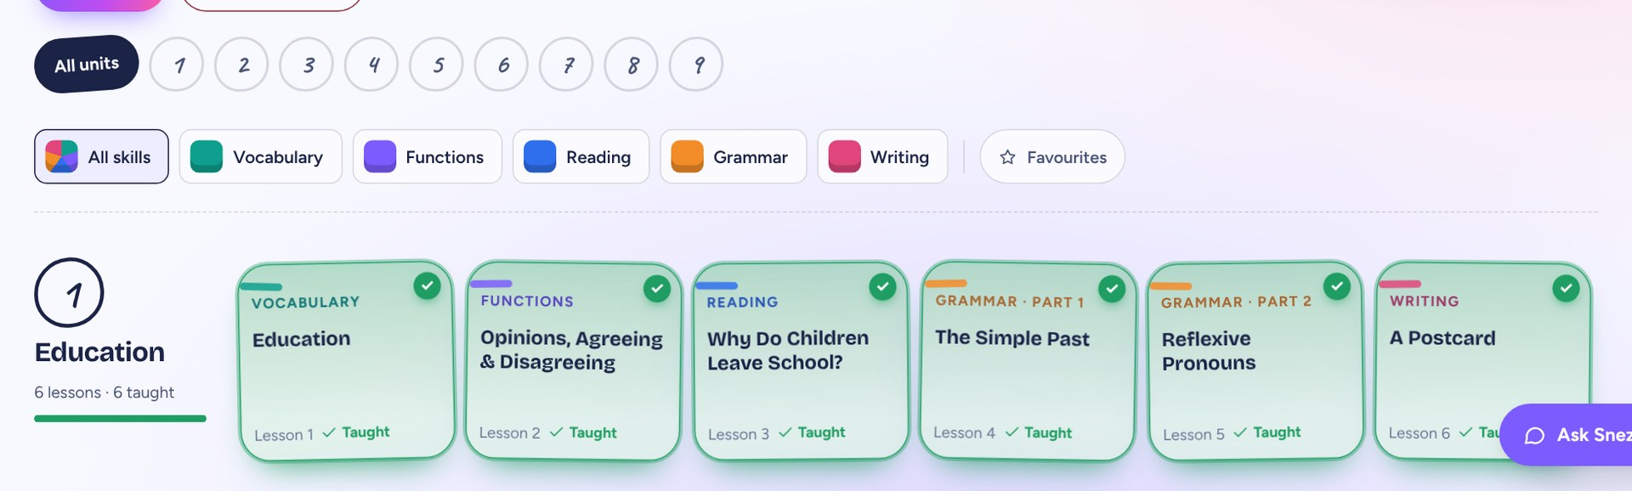
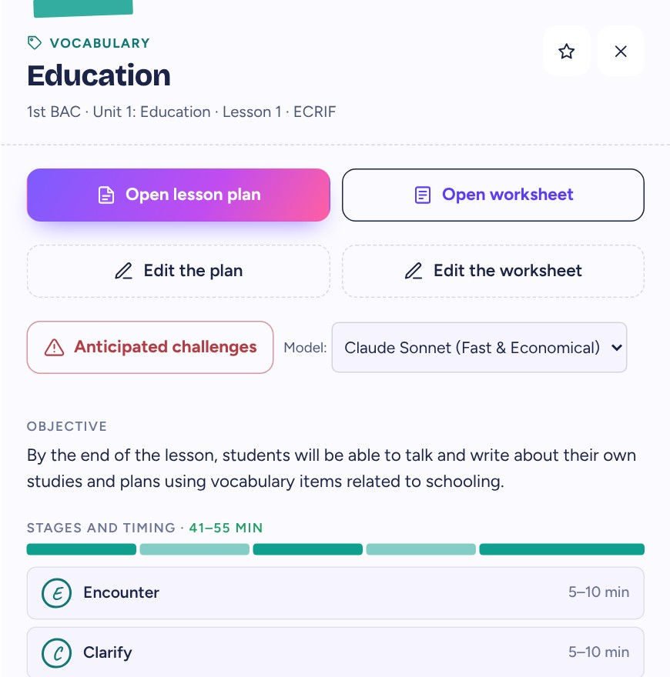
Then, everything in one place
02
Plans, worksheets and boards side by side. Click a card, and everything opens.
One pop-up per lesson: open the lesson plan, open the worksheet, or edit either one.
Notes:
Before: a plan in one folder, a worksheet in another, the board somewhere else. Now one library, colour-coded by skill (teal vocabulary, violet functions, blue reading, orange grammar, pink writing). Clicking a card opens a pop-up with Open lesson plan, Open worksheet, Edit the plan, Edit the worksheet, the objective and the five stages with their timing.

Slide 6
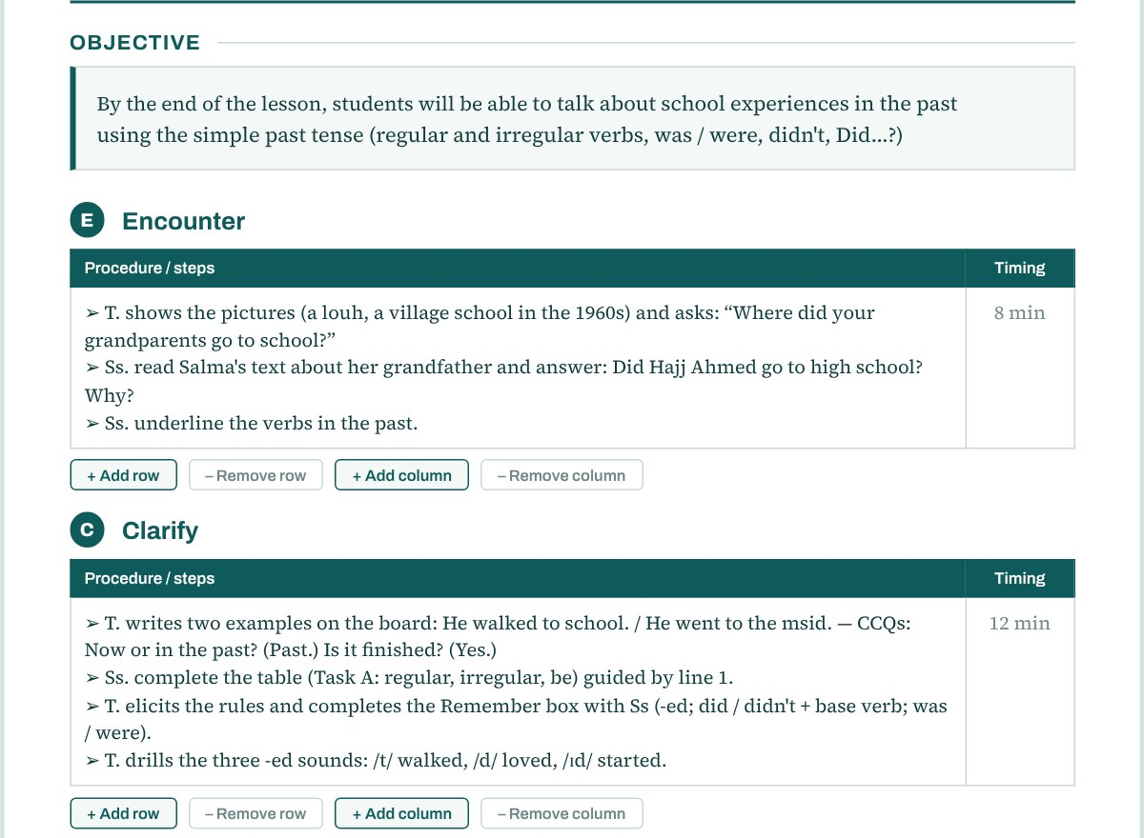
55 minutes, five clear stages
INSIDE EVERY LESSON
E
Encounter
8 min
C
Clarify
12 min
R
Remember
10 min
I
Internalize
12 min
F
Fluently use
13 min
Example: Simple Past, 1st Bac. Every lesson also has its own worksheet.
Notes:
ECRIF: Encounter, Clarify, Remember, Internalize, Fluently use. Every lesson plan is built the same way and adds up to 55 minutes, so a colleague or an inspector can read any plan quickly. The timings are from the Unit 1 Simple Past plan: 8, 12, 10, 12 and 13 minutes. The picture shows the objective and the first two stages. Plans are editable on screen and can be printed.

Slide 7
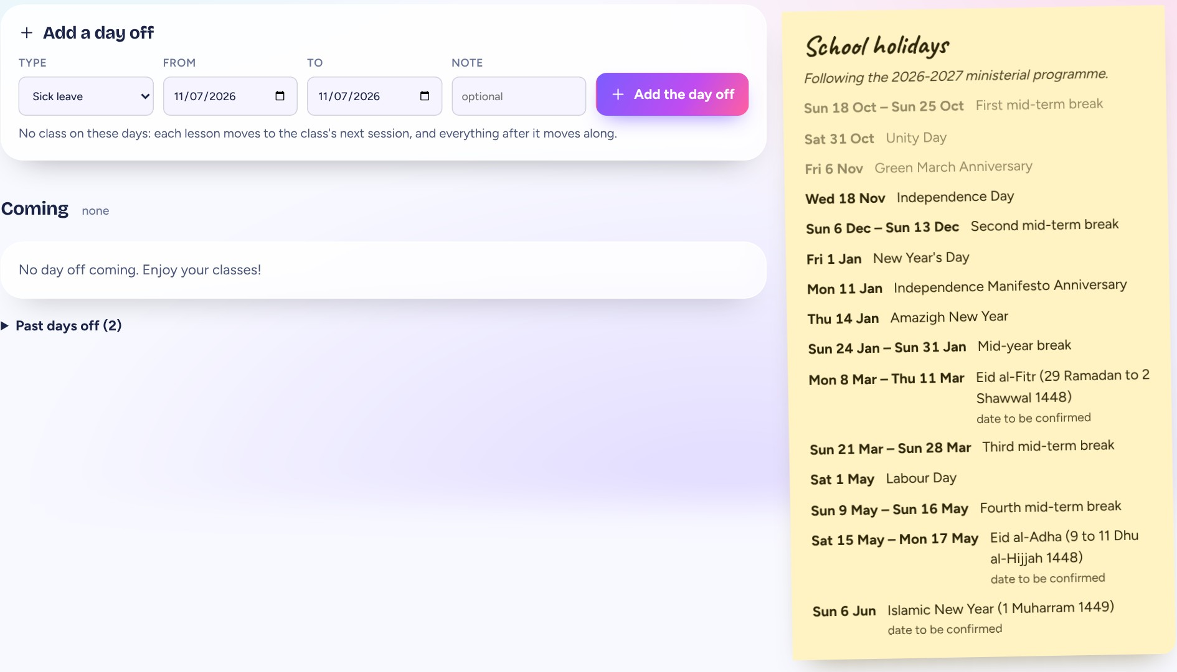
A missed class never breaks the plan
DAYS OFF
How it works
1
Add a day off: sick leave, a strike or a meeting.
2
Every class moves to its next session by itself.
3
Everything after it shifts along. Planner and timetable update.
Why it matters
Lessons are lost all year. Without this, the plan is wrong after the first missed class. The ministry holidays are already in.
Notes:
Days off panel. The teacher adds a day off, with a type (sick leave, strike, meeting), dates and a note. Every class moves to its next session by itself and everything after it moves along, so the planner, the timetable and the quiz dates stay correct. The yellow note on the right lists the ministerial school holidays, already entered.

Slide 8
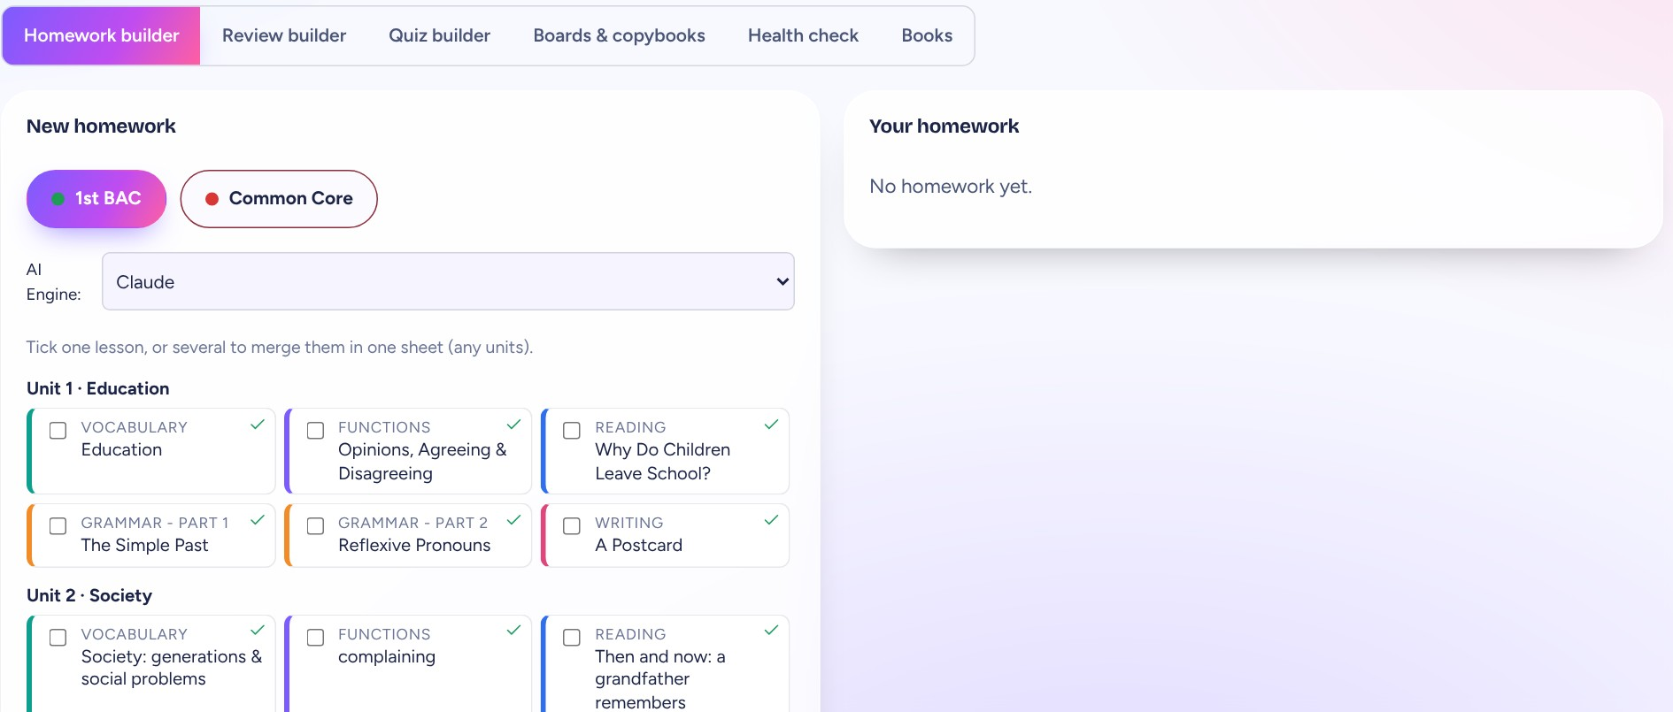
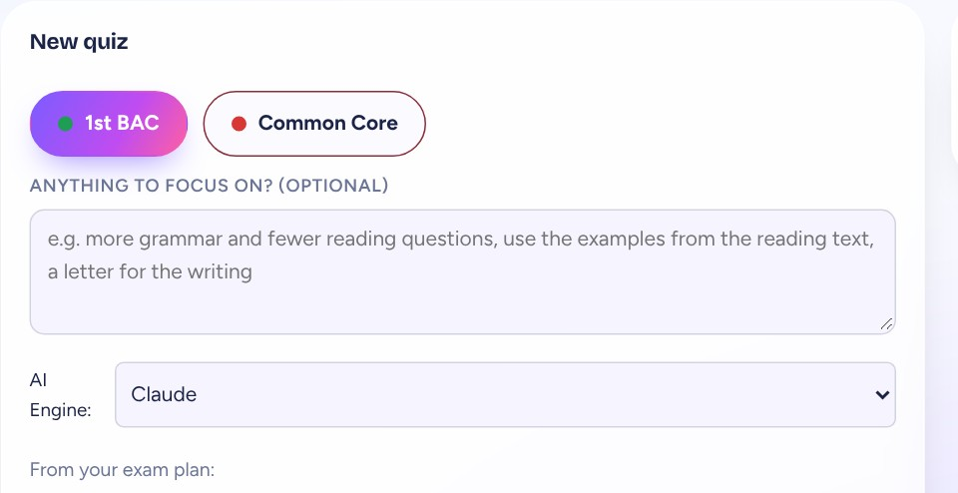
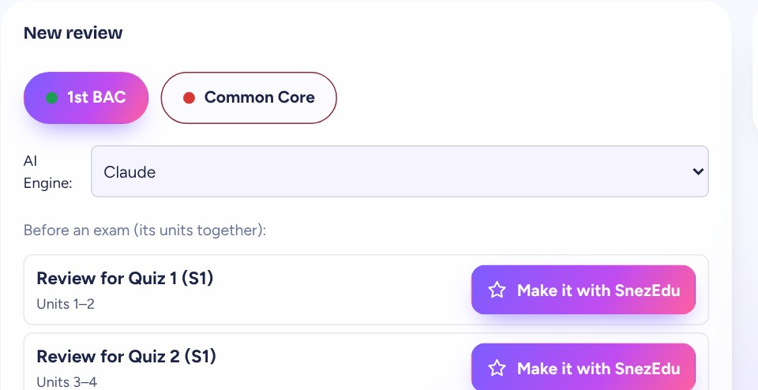
Then, I made it smart
03
Six tools in one place. AI drafts, I check every line.
Homework builder
Review builder
Quiz builder
Boards & copybooks
Health check
Books
Notes:
Six tools, all in the Tools page: the Homework builder, the Review builder, the Quiz builder, Boards and copybooks, a Health check of the library, and Books. AI drafts quizzes, reviews, homework and boards from my own lessons and the exam plan. The teacher always reads and corrects the drafts before they are used.

Slide 9
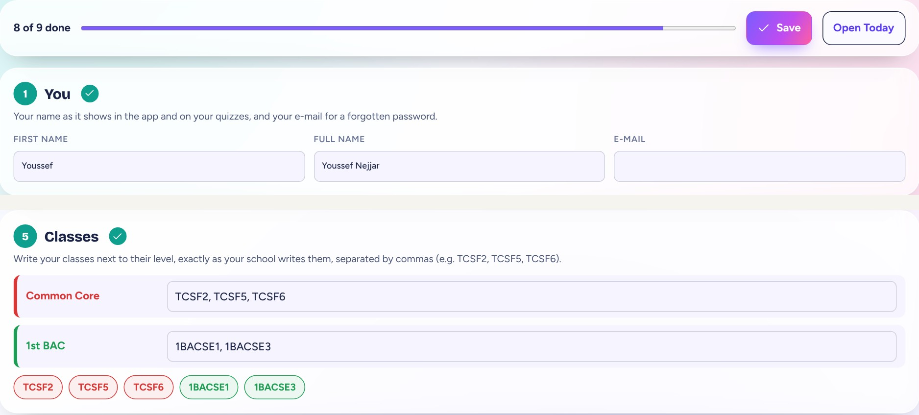
Sign in, then set up in one page
FOR TEACHERS
1 Create your account
2 Fill in Setup once
3 Today, timetable and planner fill themselves
Notes:
A colleague opens the sign-in page and creates a teacher account; the owner gives access, so a student cannot open the teachers' side. Setup is one page with nine short steps: your name, school, school days, levels, classes, timetable, rooms, exam plan and holidays. A progress bar shows how many steps are done. After Save, Today, the timetable and the planner fill themselves.

Slide 10
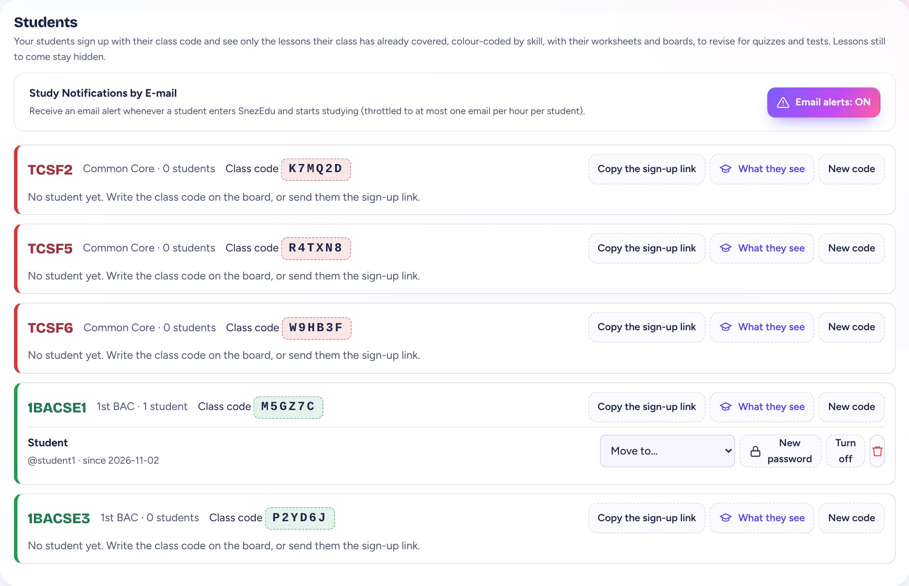
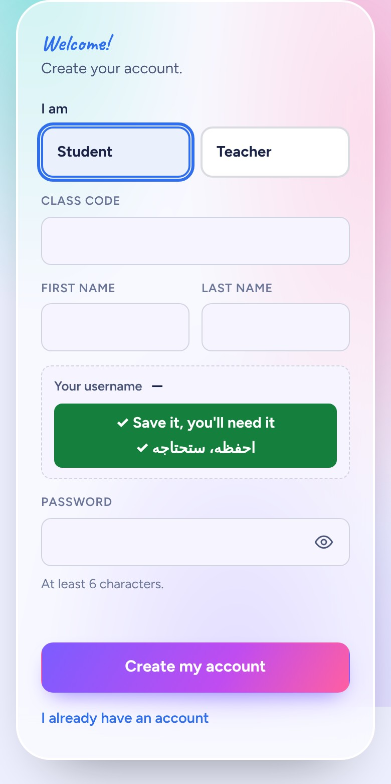
Every class has its own code
FOR TEACHERS AND STUDENTS
Teacher: a code per class, a sign-up link, a preview and a new-code button.
Student: types the code once.
Notes:
Each class gets its own six-character code. The teacher writes it on the board or sends the sign-up link. The student types the code once, picks a username and a password, and lands in the right class. What they see is only the lessons that class has already covered. If a code leaks, New code replaces it and the old one stops working. The codes shown are examples from a test copy.

Slide 11
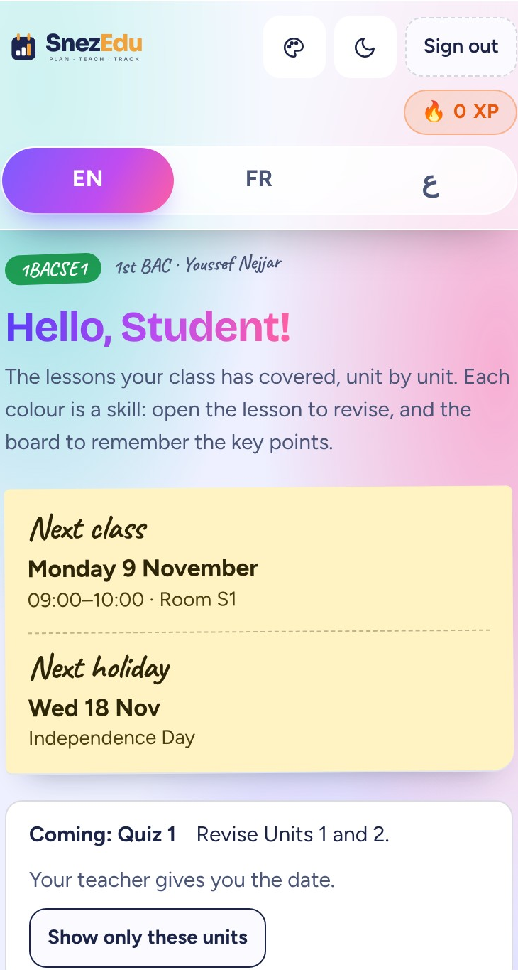
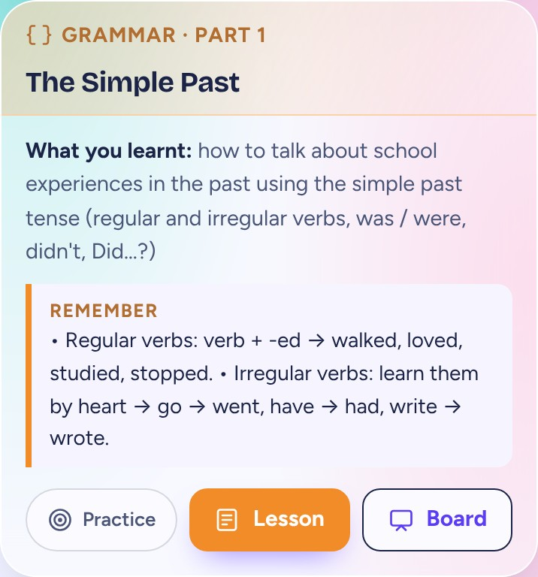
What a student sees on the phone
FOR STUDENTS
Next class and next holiday on a sticky note. Then each lesson already taught, with three buttons.
One card per lesson: Practice, Lesson, Board.
Practice
Lesson
Board
Notes:
The student sees only what the class has covered. The sticky note shows the next class and the next holiday. Every lesson card has what was learnt, what to remember, and three buttons: Practice, Lesson (the worksheet) and Board (the colourful summary). The name and class are a test student.

Slide 12
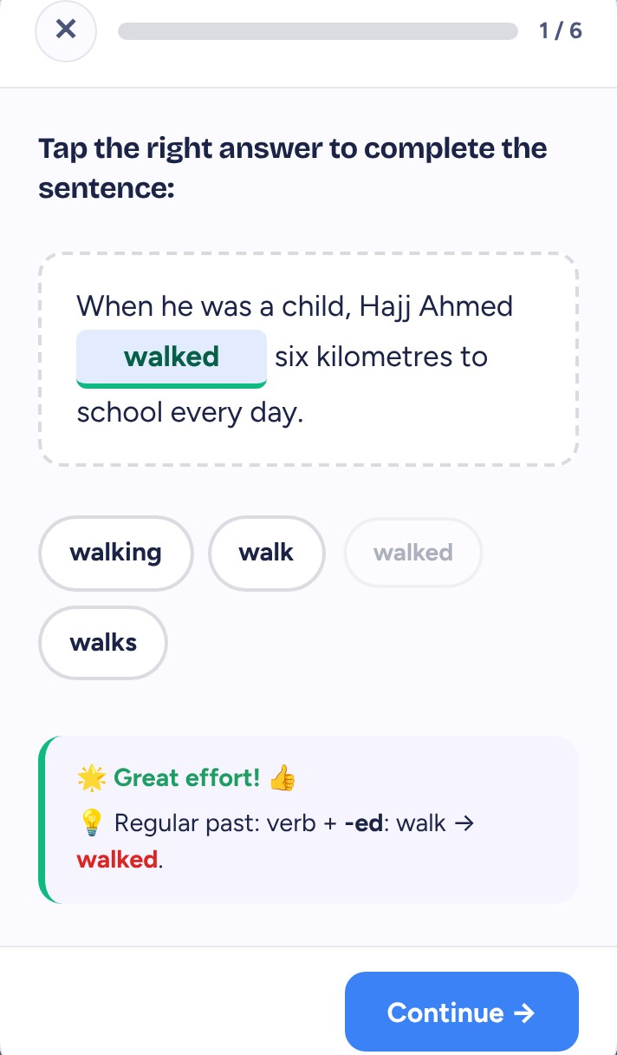
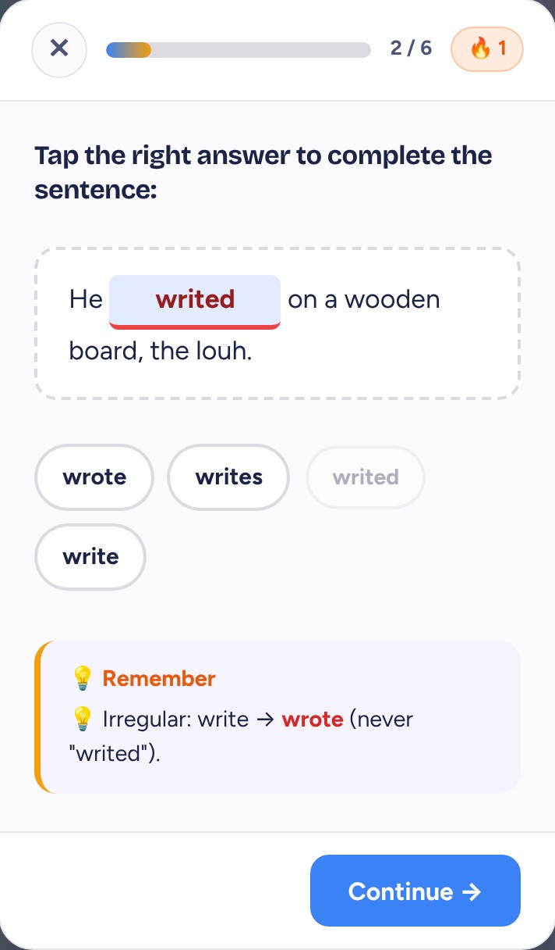
Then, I opened the door to students
04
Every answer is corrected on the spot, with the rule in one line.
+10 XP per answer
Streaks
Medals
English · French · Arabic
Right: a short note confirms it.
Wrong: the rule is shown, so the student learns.
Notes:
Students get short hand-checked questions per lesson and a longer checkpoint per unit. After each answer a note says why: for a wrong answer it shows the rule. Points and streaks motivate them, and the teacher sees how well each topic is mastered.

Slide 13
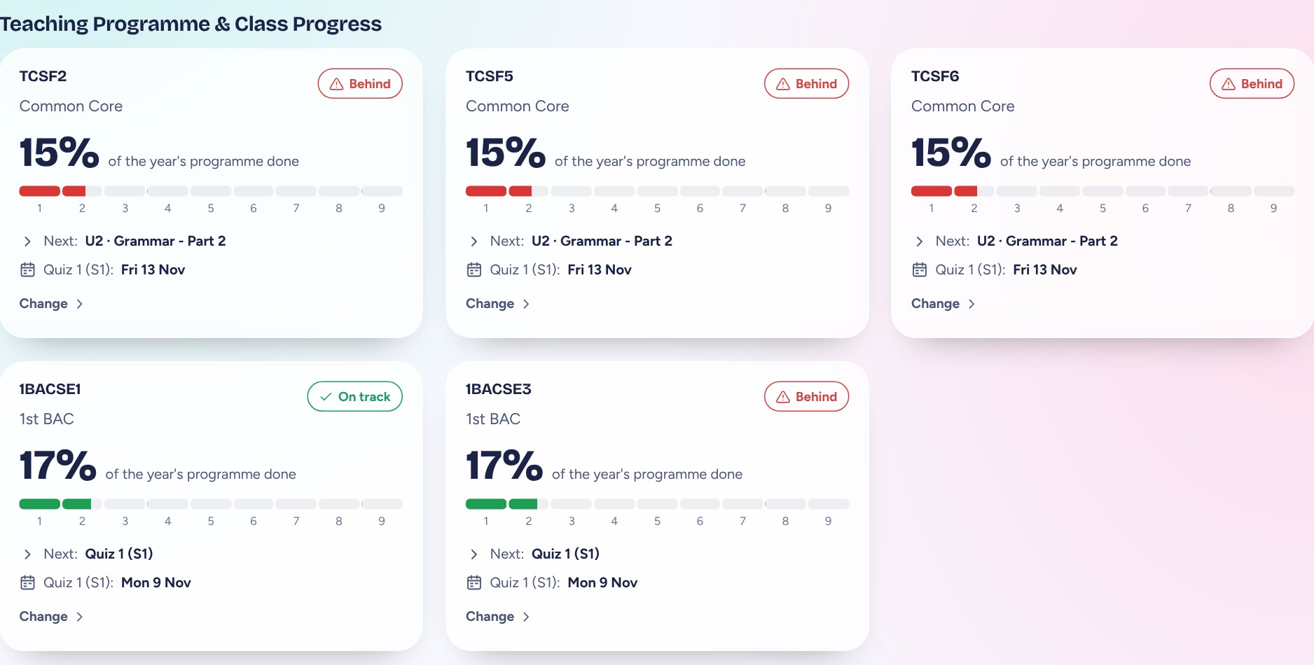
Dashboard: where each class stands
FOR TEACHERS
One card per class: how much of the year is done, on track or behind, and what comes next.
Notes:
Each card shows the share of the year's programme a class has covered, whether it is on track or behind the ministerial pace, the next lesson, and the next quiz date. A Change button lets the teacher move any of them. Below the cards, tables show classes held and lessons taught by skill.

Slide 14
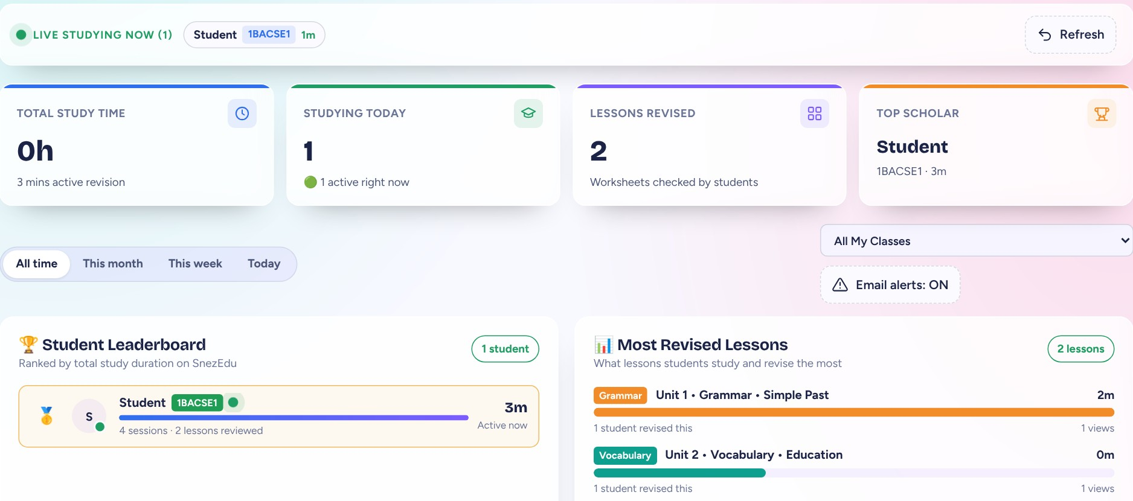
Students Progress: who studies, and how well
FOR TEACHERS
Live study monitor, a leaderboard, the most revised lessons and topic mastery.
Notes:
The teacher sees who is studying right now, how long students revise, which lessons they revisit, and a leaderboard. A mastery section shows the share of practice questions each class gets right. The students on this screen are test accounts.

Slide 15
Two dashboards, one platform
IN SHORT
Teachers have
Students have
Planner and timetable for the whole year
Lessons already taught, by unit and skill
Library of plans, worksheets and boards
Worksheets and boards to revise
AI drafts of quizzes, reviews and homework
Practice with a one-line explanation
Dashboard: progress and pace of every class
XP, streaks and medals
Students Progress: who studies and what they master
English, French or Arabic, light or night
Teachers plan and check. Students revise and practise. Both use the same platform.
Notes:
Left: what a teacher gets. Right: what a student gets. Everything a student sees is limited to lessons the class has already covered; everything the teacher sees is private to that teacher.

Slide 16
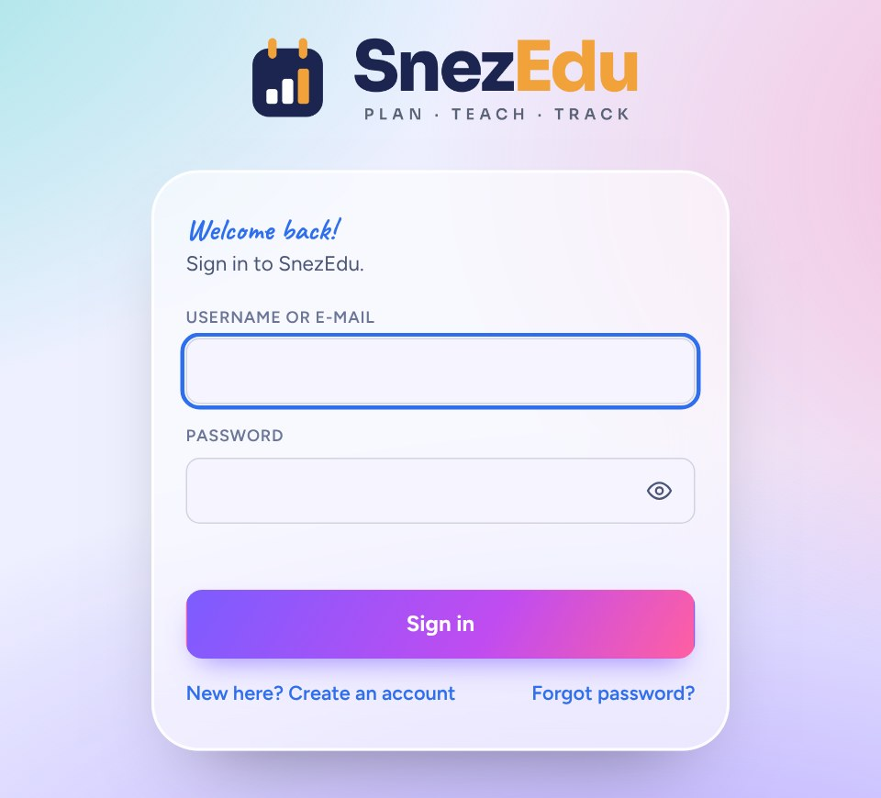
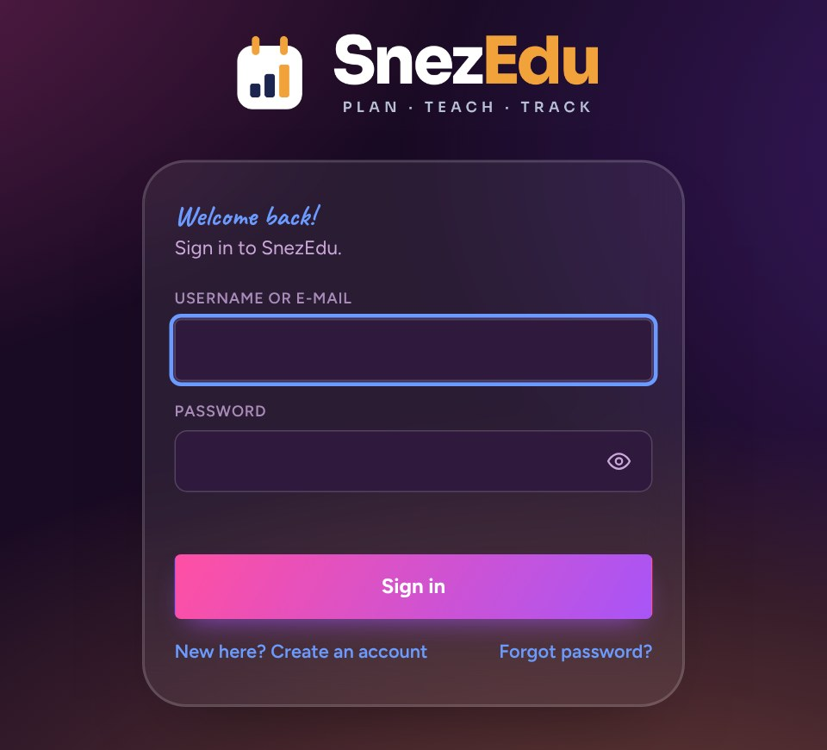
One sign-in, on any device, day or night
Light mode
Night mode
Notes:
Teachers and students sign in from the same page on a phone or a computer. The page has a language switch and a light and night switch. Colleagues can create their own account.

Slide 17
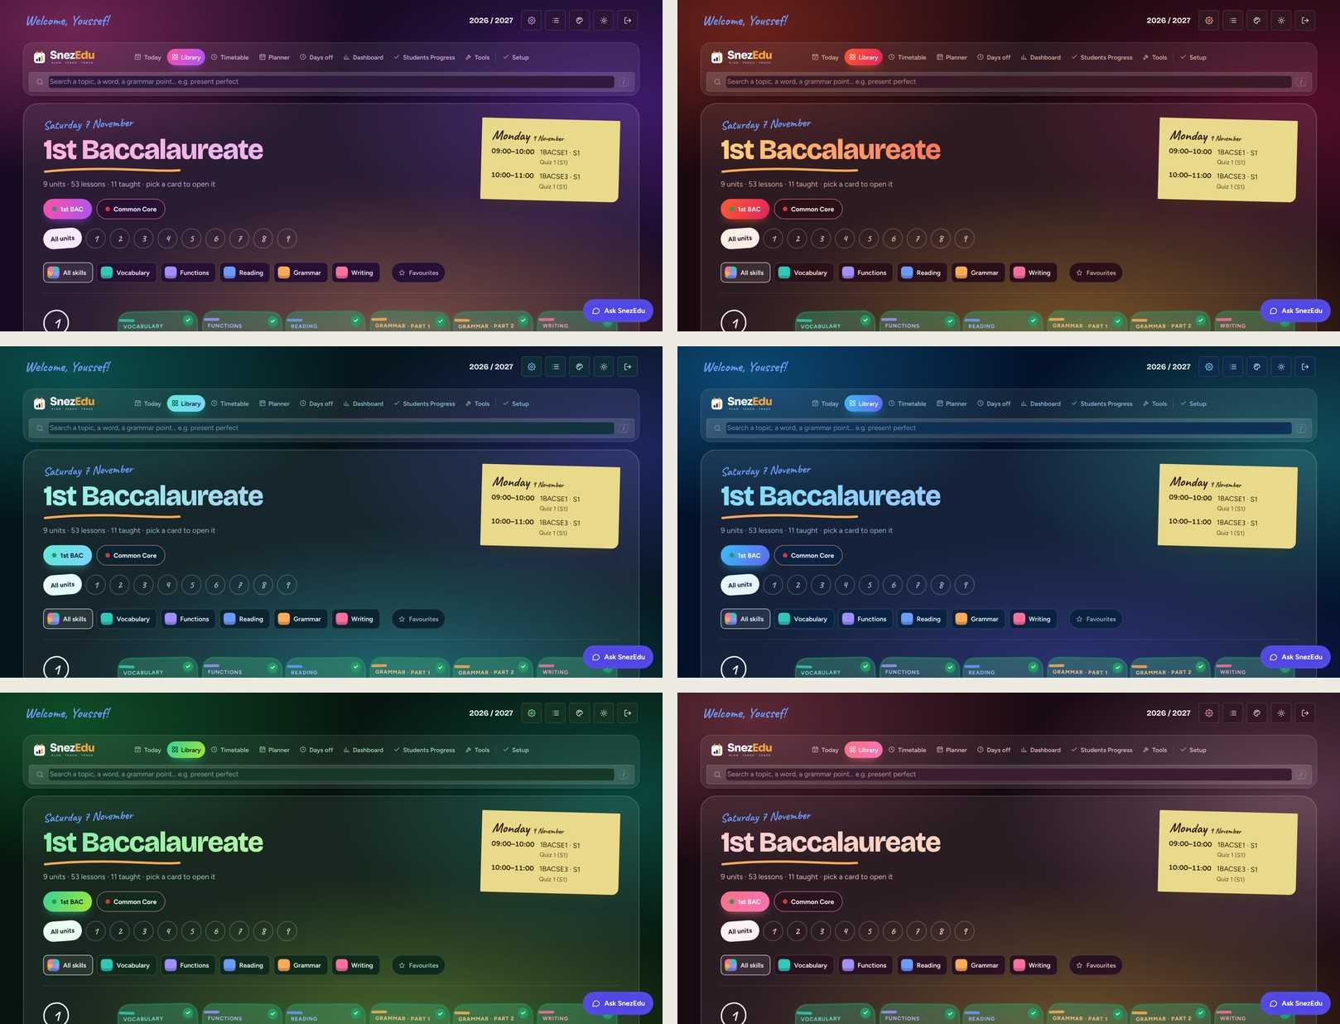
Night mode, six palettes
Make it yours
Teachers and students pick the look they like.
Notes:
The app has 6 night palettes and 7 light palettes, 13 in all. The choice is saved per browser, so every teacher and student keeps their own look.

Slide 18
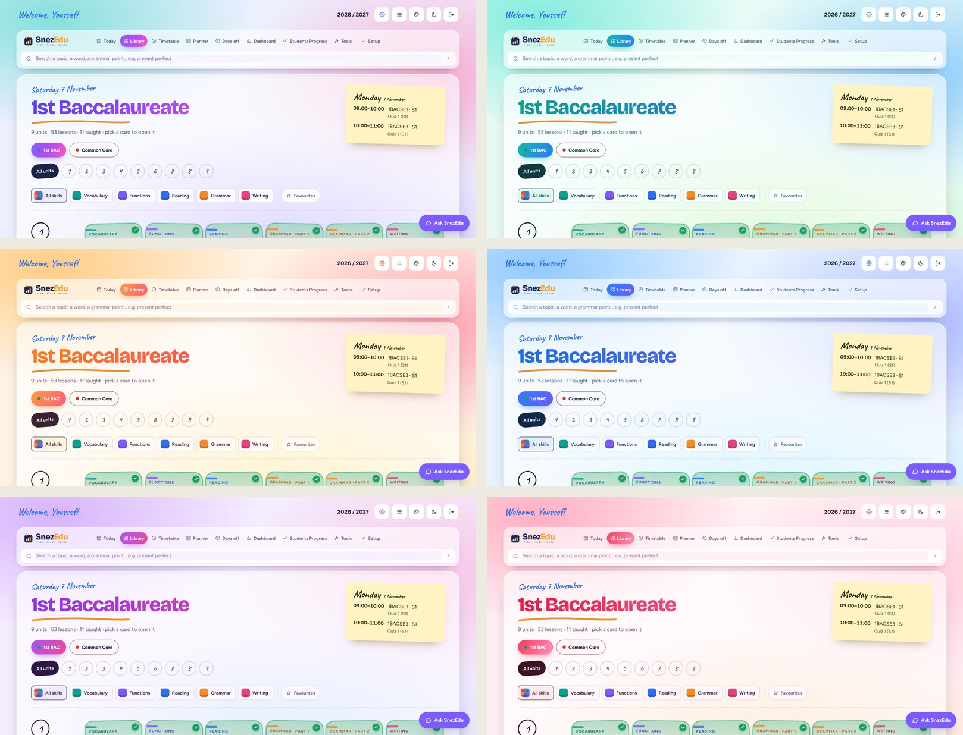
Light mode, bright and calm
Make it yours
The same screens, ready for the classroom or for print.
Notes:
Seven light palettes exist; six are shown here. Light mode is the one to use for printing.

Slide 19
One platform, three promises
1
2
3
Plan the whole year.
Find every lesson in one place.
Keep every student learning.
Youssef Nejjar · Teacher of English
Notes:
Close on the three promises, then take questions. Every claim on these slides is backed by a working screen in the platform.

